Slide 1
Spam Classifier Tutorial
CS3300 Data Science
RJ Nowling

Slide 2
Problem Definition
We want to predict whether a given email is spam or not.

Slide 3
Data Set
trec07p – University of Waterloo
~ 75k emails from between April and July 2007
~25k ham
~50k spam
Used 75% for training, 25% for testing

Slide 4
Dear Class, I've uploaded the new homework to D2L. It's due on Monday. I'm looking forward to seeing your solutions! RJ
?
[0, 1, 0, 0, 0, 1, 1, 0, 0]

Slide 5
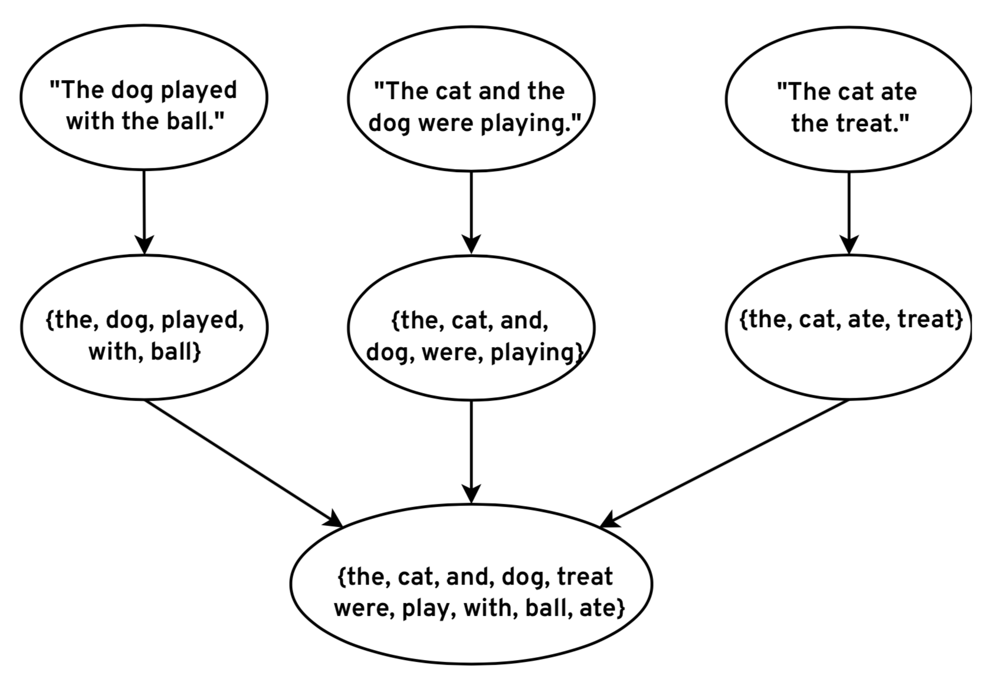
Extract Vocabulary

Slide 6
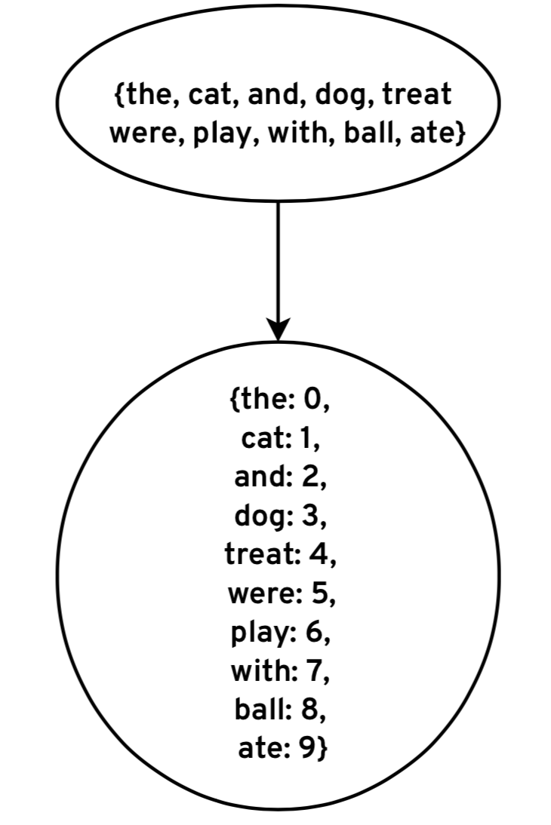
Map Words to Column Indices

Slide 7
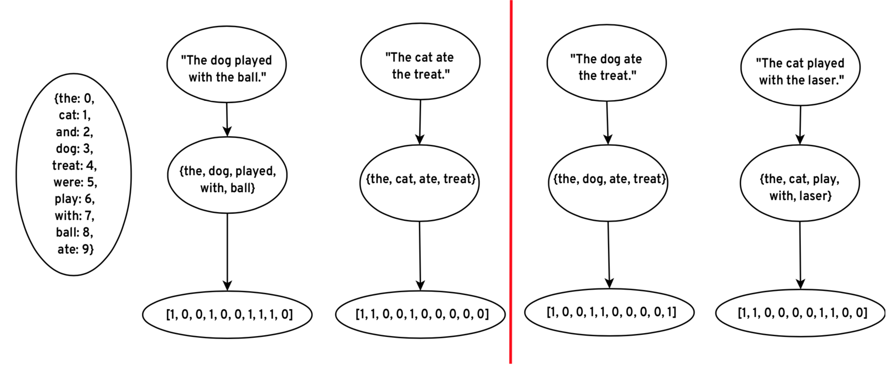
Encode Features

Slide 8
Encode Features

Slide 9
From xlvwscs@net.il Wed Apr 11 21:18:50 2007
Return-Path: xlvwscs@net.il
Received: from DSL217-132-183-148.bb.netvision.net.il (89-139-22-235.bb.netvision.net.il [89.139.22.235])
by speedy.uwaterloo.ca (8.12.8/8.12.5) with ESMTP id l3C1Im0I024199
for <gnitpick@speedy.uwaterloo.ca>; Wed, 11 Apr 2007 21:18:49 -0400
From: "repairs" xlvwscs@net.il
To: gnitpick@speedy.uwaterloo.ca
Subject: Secure Web-Form
Date: Thu, 12 Apr 2007 04:18:33 -0300
MIME-Version: 1.0
Content-Type: multipart/related;
boundary="----=_NextPart_000_0004_01C77CB9.A20DDD00"
X-Mailer: Microsoft Office Outlook, Build 11.0.5510
Thread-Index: Acd8uaINCus5OCPWRZ2d2pVdMAveNQ==
X-MimeOLE: Produced By Microsoft MimeOLE V6.00.2900.2869
Message-Id: <FC6B2A13C68B036.F7152FB58C@net.il>

Slide 10
From: "repairs" xlvwscs@net.il
X-Mailer: Microsoft Office Outlook, Build 11.0.5510

Slide 11
Domains
net.il => { net.il, il }
amazon.co.uk => { amazon.co.uk, co.uk, uk }
User Agents
Microsoft Office Outlook, Build 11.0.5510 =>
{ microsoft, office, outlook, build, 11, 0, 5510 }
Thunderbird 1.5 (Windows/20051201) =>
{ thunderbird, 1, 5, windows, 20051201 }

